Slide 1
Multi-AGV Path Planning with Double-Path Constraints by Using an Improved Genetic Algorithm
Zengliang Han, Dongqing Wang, Feng Liu and Zhiyong Zhao
PLOS ONE, July 26, 2017
Presenter: Chih-Hsuan Chien
Date: May. 3, 2022

Slide 2
Abstract
This paper investigates an improved genetic algorithm on multiple automated guided vehicle (multi-AGV) path planning. The innovations embody in two aspects. First, three-exchange crossover heuristic operators are used to produce more optimal offsprings for getting more information than with the traditional two-exchange crossover heuristic operators in the improved genetic algorithm. Second, double-path constraints of both minimizing the total path distance of all AGVs and minimizing single path distances of each AGV are exerted, gaining the optimal shortest total path distance. The simulation results show that the total path distance of all AGVs and the longest single AGV path distance are shortened by using the improved genetic algorithm.

Slide 3
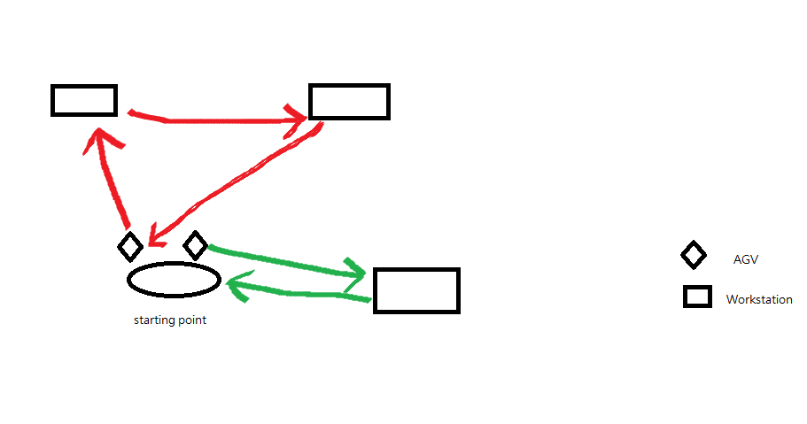
Constraints
M AGVs traverse through N workstations (N > M).
Only one AGV passes through each workstation.
Every AGV has a minimum path.
Each AGV starts from the same starting point (workstation) and comes back to the starting point.

Slide 4
Input:
Num of workstation,AGV
Minimum path of single AGV
Population,Iteration
Output:
Path planning
Total path distance
Maximal path distance of single AGV

Slide 5
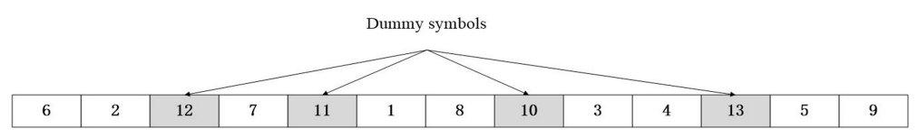
Gene encoding
10 workstations, 5 AGV
0--6--2--0
0--7--0
0--1--8--0
0--6--2--0
0--3--4--0
0--5--9--0

Slide 6
Infeasible solution
0--0--0
0--2--6--7--0
0--1--8--0
0--3--4--0
0--5--9--0
0--6--2--0
0--7--8--1--0
0--0--0
0--3--4--0
0--5--9--0

Slide 7

Selection
$P_{i}=fⅈ/\sum_{k=1}^{Q}{f_{k}}$

Slide 8
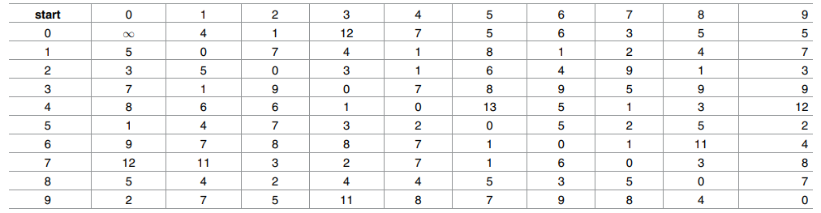
Three-exchange heuristic crossover
A = 6 2 12 7 11 1 8 10 3 4 13 5 9
B = 3 2 12 7 9 11 1 4 13 5 10 6 8
C = 5 3 10 8 7 11 2 6 12 1 4 13 9
S = 6 ＊＊＊＊＊＊＊＊＊＊＊
d(6,2)=8 , d(6,8)=11 , d(6,12)=d(6,0)=9
A = 6 2 12 7 11 1 8 10 3 4 13 5 9
B = 6 2 12 7 9 11 1 4 13 5 10 8 3
C = 6 2 12 1 4 13 9 5 3 10 8 7 11

Slide 9
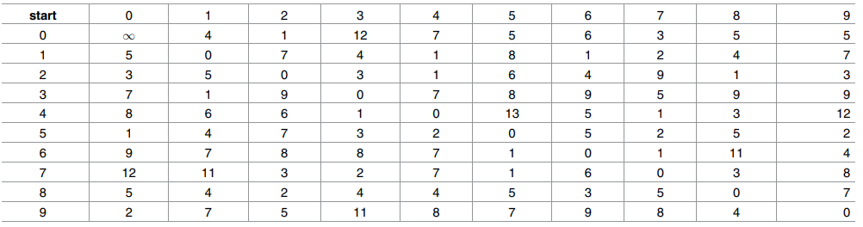
A = 6 2 12 7 11 1 8 10 3 4 13 5 9
B = 6 2 12 7 9 11 1 4 13 5 10 8 3
C = 6 2 12 1 4 13 9 5 3 10 8 7 11
S = 6 2 12 ＊＊＊＊＊＊＊＊＊
d(0,7)=3 , d(0,1)=4
S = 6 2 12 7 9 11 1 4 13 5 10 8 3

Slide 10
Mutation
a = 2, b = 5 and c = 10
A = 6 2 12 7 11 1 8 10 3 4 13 5 9
A = 6 1 8 10 3 4 2 12 7 11 13 5 9

Slide 11
